Slide 1
Team-project: Abstraction and Reasoning Corpus Competition

Slide 2





Introduction to the ARC competition
What is the ARC Competition?
Judging and Awards
Benchmark for progress in Artificial General Intelligence (AGI)
Hosted by Mike Knoop (Co-Founder) and François Chollet (Creator)
Submissions evaluated on percentage of correctly solved puzzles of private evaluation set
Best submitted solutions and papers earn prize money
Participation and Eligibility
Reoccurring open kaggle competition
1,427 teams with 16,956 submissions in 2024 occurrence
Challenge
Submit code that is able to solve unseen reasoning puzzles
Easy public puzzles accessible to train models on puzzle format
Notes:
‹#›

Slide 3
1. Significance of the ARC Prize
Launched to reignite AGI research by promoting open innovation.
Aims to tackle fundamental unsolved AI problems rather than incremental improvements.
Impact: Boosted the ARC-AGI private evaluation score from 33% to 55.5%, demonstrating significant progress in AGI reasoning.
2. Importance of the ARC-AGI Benchmark
Regarded as "the most important unsolved AI benchmark in the world."
Unlike traditional AI benchmarks, it evaluates generalization on novel tasks..
Serves as a concrete framework for defining and assessing AGI, focusing on adaptability and problem-solving beyond pretraining.
3. Challenge and Stagnation in AI Research
ARC-AGI has remained unbeaten for five years despite advancements in AI.
From 2020 to early 2024, AI research focused on scaling deep learning models, which enhanced task-specific abilities but failed to achieve generalization.
The competition highlights the gap between current AI capabilities and AGI, emphasizing the need for fundamental breakthroughs rather than just larger models.
Notes:
6

Slide 4

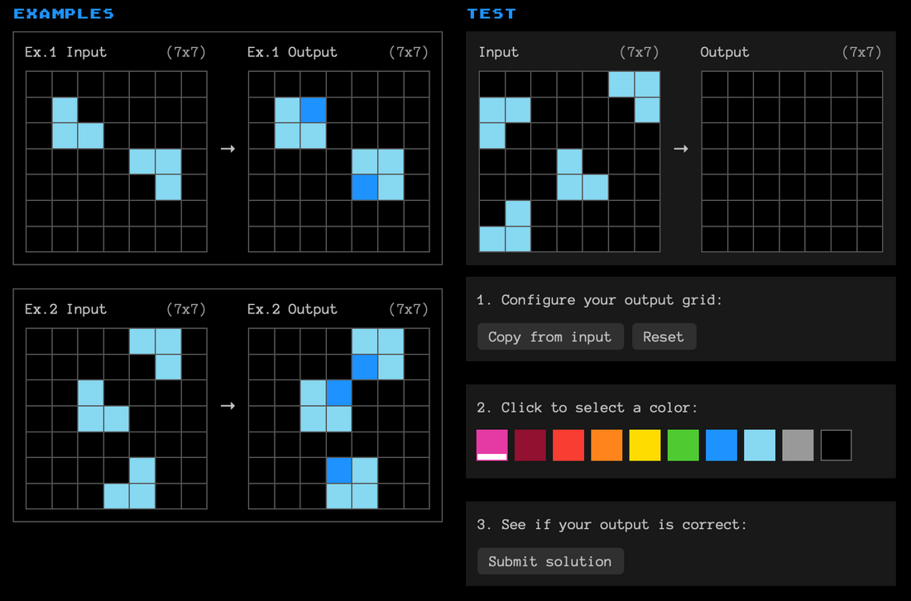

DATASET
Task example
Public Training
Public Evaluation
Private Evaluation
Amount of tasks
400
400
100
Difficulty
easy
hard
hard
Used for
Model-Training
Public Leaderboard
Final Scoreboard
https://arcprize.org
Notes:
3

Slide 5




Framework conditions
Resource limitations and the benchmark's goal
No internet access
Maximal code run-time
External data and pre-trained models allowed
8 hours
Benchmark target
CPU and GPU run-time
85% on private evaluation
CPU <= 12 hours run-time
Progress towards AGI without relying on scaling
GPU <= 12 hours run-time
Notes:
4

Slide 6



Why AI models struggle with AGI
Static Inference
LLMs are trained once on a vast dataset, and once training is complete, they do not update their knowledge dynamically
During inference, they rely on the parameters learned during training.
They struggle to adapt to unseen problems or rapidly changing environments.
Memorization over Generalization
They Fail at abstract problem-solving and logical reasoning beyond what they were trained on.
Studies show that even as LLMs grow, their ability to generalize does not significantly improve, which limits their potential for AGI
Picture Source:
Generated by ChatGPT-4o
Notes:
5

Slide 7
Top three prize winning approaches
1. Winner: the ARChitects
Score: 53.5%
Model: Test-Time Training (TTT)
2. 2nd Place: Guillermo Barbadillo
Score: 40%
Model Test-Time Training (TTT)
3. 3rd Place: alijs
Score: 40%
Model: Test-Time Training (TTT)
Test-Time Training (TTT)has shown promising results in improving model adaptability. By refining
model weights during inference using a loss function applied to test
inputs.
TTT enables models to generalize better to novel ARC tasks
Notes:
‹#›

Slide 8
Approach of the third prize winner (G. Barbadillo):
The Omni-ARC approach to the 2024 Abstraction and Reasoning Challenge (ARC) emphasizes data efficiency and abstraction by training a transformer model to perform multiple ARC-related tasks, aiming to develop a robust representation of the problem space.
Training Strategies:
Data Augmentation: Applied various transformations, such as geometric changes, padding, upscaling, and mirroring, to both inputs and outputs to enhance model robustness.
Problem Augmentation: Utilized different ARC problems to train the model across multiple tasks, including output prediction, input distribution learning, and code generation, fostering a comprehensive understanding of the ARC problem space.

Slide 9
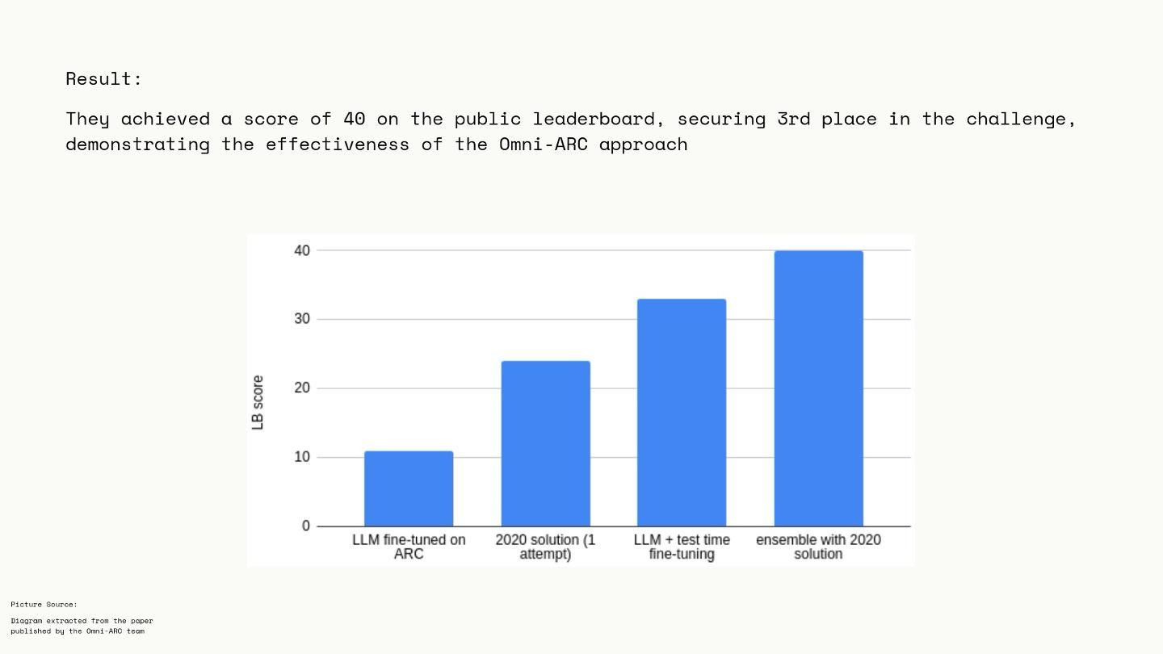
Result:
They achieved a score of 40 on the public leaderboard, securing 3rd place in the challenge, demonstrating the effectiveness of the Omni-ARC approach
Picture Source:
Diagram extracted trom the paper published by the Omni-ARC tean
Notes:
6

Slide 10
Our Models
Original Baseline model with reasoning
Created a Baseline model without Reasoning
Hyperparameter Tuning
Candidate Sampling
Notes:
‹#›

Slide 11
Strengths of our model:
Improved Interpretability: Ensures transparency and understanding of the model's decisions.
Efficient Debugging: Helps identify errors and refine logic effectively.
User Confidence: Builds trust by showing logical steps behind outputs.
Alignment with ARC-AGI Goals: Demonstrates task understanding and problem-solving logic.
Supports Generalization: Provides insights for improving adaptability to diverse tasks.
Weaknesses:
Inability to Handle Certain Cases
Despite its strengths, the model fell short of delivering the desired outputs for certain example, where the reasoning was logical but contained minor prediction errors
Notes:
6

Slide 12
Methodology

Slide 13
Methodology: Overview
Fine-tuned Model
Instruction-tuning
PEFT via Unsloth
rsLoRA
41,943,040 parameters trained (roughly 0.5% of total # of parameters)
Enhanced Dataset
Based on benchmark training dataset
Enhanced via manually labored reasonings
Push model towards CoT reasoning
LLaMa 3.1 8B Instruct
Pre-trained foundation
Already tuned on general instruction answering
32 Layers
32 Attention Heads - hidden size 4096
FNN intermediate size of 14,336

Slide 14

Methodology: The original dataset
Task Example
Demonstration Pairs
2-10 per Task
Show transformation rule
2-dim arrays wrapped in JSON
Varying grid dimensions
Only single digits (0-9)
Each color represents one digit
Test Inputs
1-3 per Tasks
Apply transformation rule
Same JSON-Format
Human Interface
https://arcprize.org/

Slide 15
Methodology: The original dataset
Composition of ARC-AGI-1
 | Training | Evaluation-1 | Evaluation-2
Access Level | Public | Public | Private
No. of Tasks | 400 | 400 | 100
Difficulty | easy | hard | hard
With Solutions | ✅ | ✅ | ❌
Usage | Training | Public Score | Final Score
We enhance and fine-tune on this part
We evaluate the model on this part

Slide 16
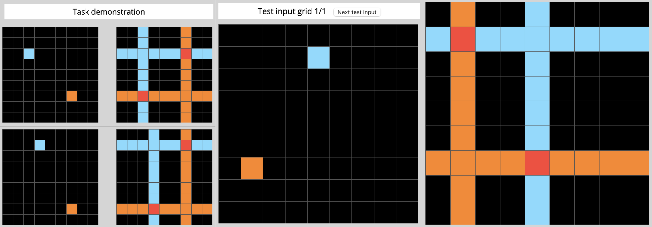
Methodology: The enhanced dataset
Adding human reasonings
Screenshot of local task visualizer
Overall rule:
First the input is copied, then we fill for each non-zero value its horizontal and vertical line with the same non- zero value. If two lines cross each other this specific entry gets the value 2 at the intersection.
Dimension:
Therefore the output dimensions are the same as the input dimensions.
Values:
The non-zero values of the input define the values of the added vertical and horizontal lines (except for the case of intersections).
Changed Values:
For each non-zero in the input the whole vertical and horizontal line of that entry will be changed.

Slide 17
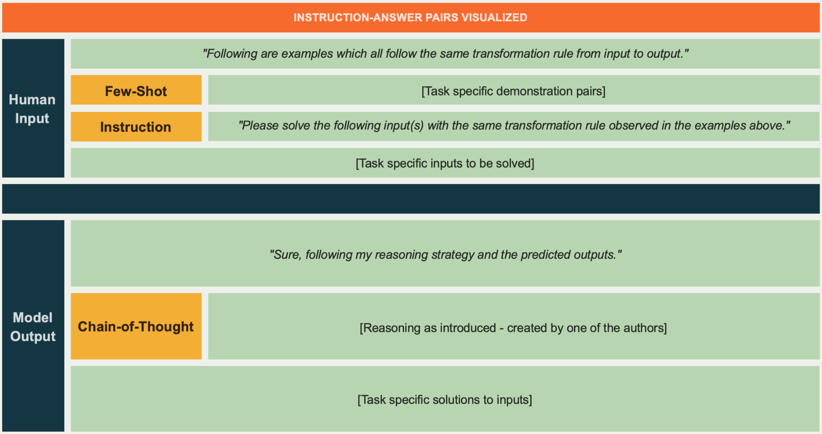
Methodology: Fine-Tuning
Instruction-Answer Pair Structure

Slide 18
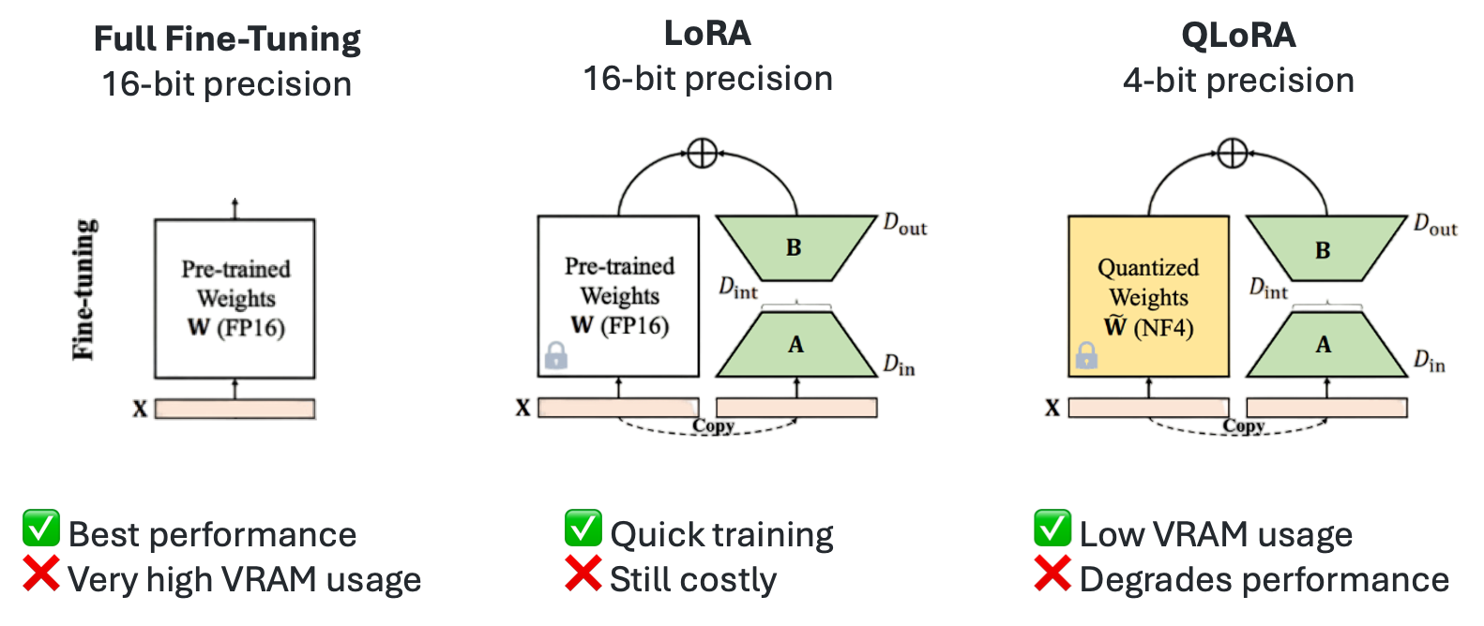
Methodology: Fine-Tuning
PEFT (1) - rsLoRA
https://imgur.com/P6sLsxl
Our choice + prevent rank collapse through rank stabilizing factor

Slide 19

Methodology: Fine-Tuning
PEFT (2) - Unsloth and initial HP-settings
Why use Unsloth?
→ QLoRA integration (convenient, but not applicable for us)
→ TRL integration (convenient for SFT etc.)
→ Easy of use (High-Level API)
→ VRAM efficiency!!! (Asynchronous offloading of activation tensors)
https://github.com/unslothai/unsloth
LoRA HPs
Rank = 16
Alpha = 16
Rank stabilized = TRUE
No dropout
Target Modules
Q, K, V - weight matrices
Linear projection weight matrices
Attention output weight matrices
SFT HPs
LR = 3e-4
LR Scheduler = Linear
Batch Size = 8
Epochs = 1
Warmup Steps = 10
Optimizer = adamw_8bit
Dataset Processors = 2

Slide 20
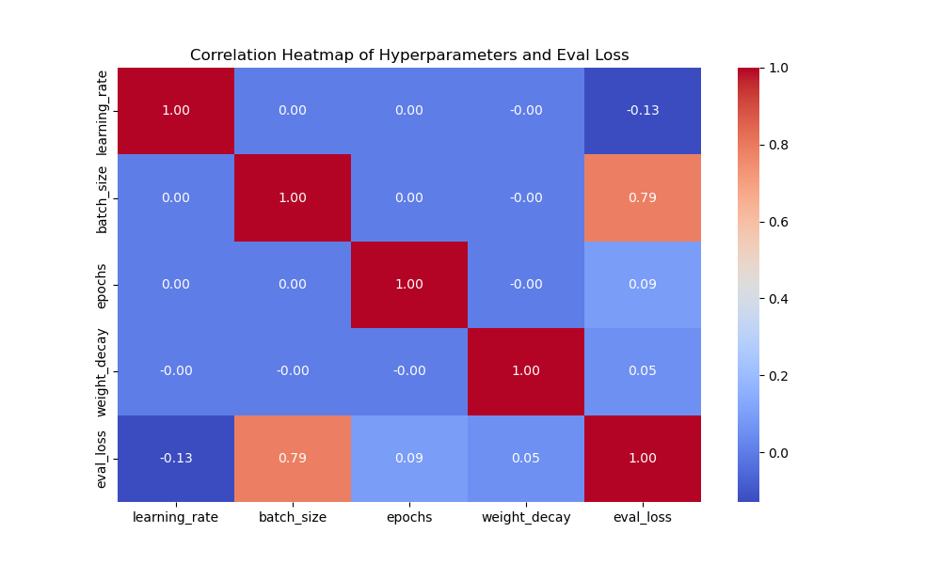
Methodology: HP-Tuning
Grid Search Setup & Key Insights
Hyperparameter | Tested Values
Learning Rate | 5e-5, 1e-4, 5e-4
Batch Size | 4, 8, 16
# of Epochs | 1, 3, 5
Weight Decay | 0.01, 0.1
With
reasonings
54 configurations each
Hyperparameter | Tested Values
Learning Rate | 5e-5, 1e-4, 5e-4
Batch Size | 4, 8, 16
# of Epochs | 1, 3, 5
Weight Decay | 0.01, 0.1
Without
reasonings

Slide 21
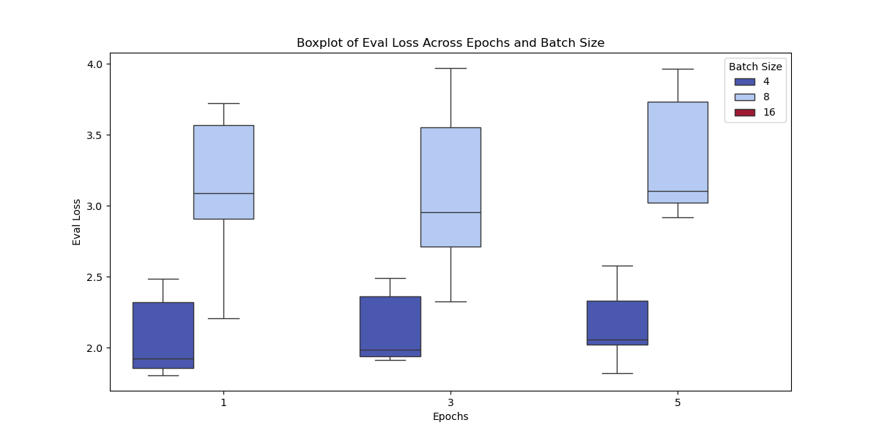
Methodology: HP-Tuning
Grid Search Setup & Key Insights

Slide 22
Challenges during training
Appreciated challenges 😊
Time- and resource limits
How to work around them?
Using bwUniCluster2.0 for the first time
Using LabRoom PC or Kaggle Editor
How to fine-tune a LLM
Training with Unsloth
Complexity of ARC-AGI and AGI in general
Are LLMs the answer?
If yes, which model should we pick?
If yes, how improve reasoning abilities?
→Time-consuming but high learning effect!!!
Unappreciated challenges 😕
Contested cluster resources → unpredictability of working hours
Random one time failures (e.g. reaching university sided file limit on cluster) → caused confusion if cluster usage is understood properly
Unsloth dependencies were very sensitive using pip → much time used to setup a reliably running kernel (should be better by now)
→ Time-consuming but low learning effect…

Slide 23
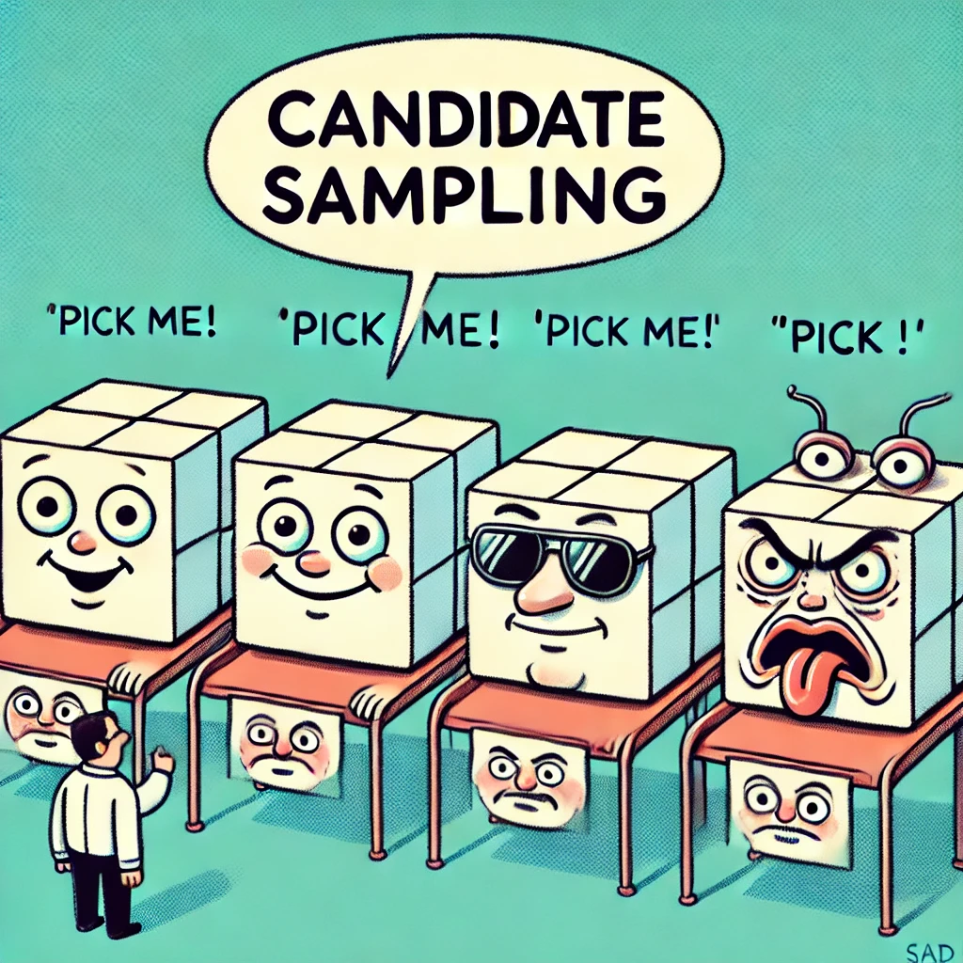
Candidate Sampling: Improving Model Robustness
Why?
Models struggle with single deterministic outputs; ranking multiple solutions improves robustness.
How?
Instead of directly predicting one output, the model evaluates multiple candidate solutions
Key Idea
Introduce noise into correct solutions to create alternative candidates
BigBird-RoBERTa model was chosen for the objective
Image Source: Generated by ChatGPT

Slide 24
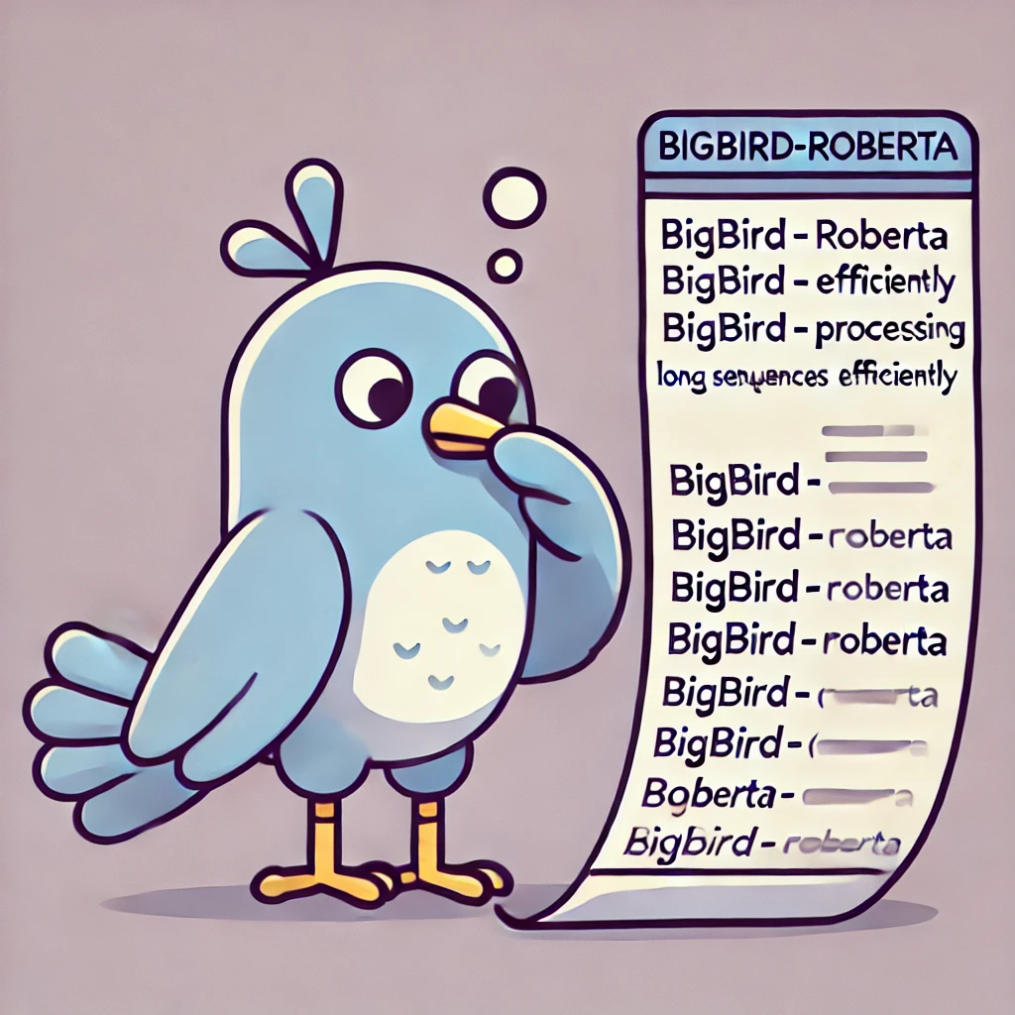
Why BigBird for Candidate Sampling?
Long-Sequence Processing
Ranking Capabilities
Memory efficiency
Hyperparameters
Epochs: 3
Learning Rate: 5e-5
Batch Size: 2
Loss Function: Mean Squared Error
Image Source: Generated by ChatGPT

Slide 25
Candidate Sampling: Training the Model
Step 1: Extract the correct solution from the dataset.
Step 2: Introduce controlled noise to create 4 incorrect versions.
Step 3: Assign confidence scores based on how much noise was introduced.
Step 4: Model is trained to rank these candidates

Slide 26
Inference and Results

Slide 27
Prediction Accuracy

Slide 28
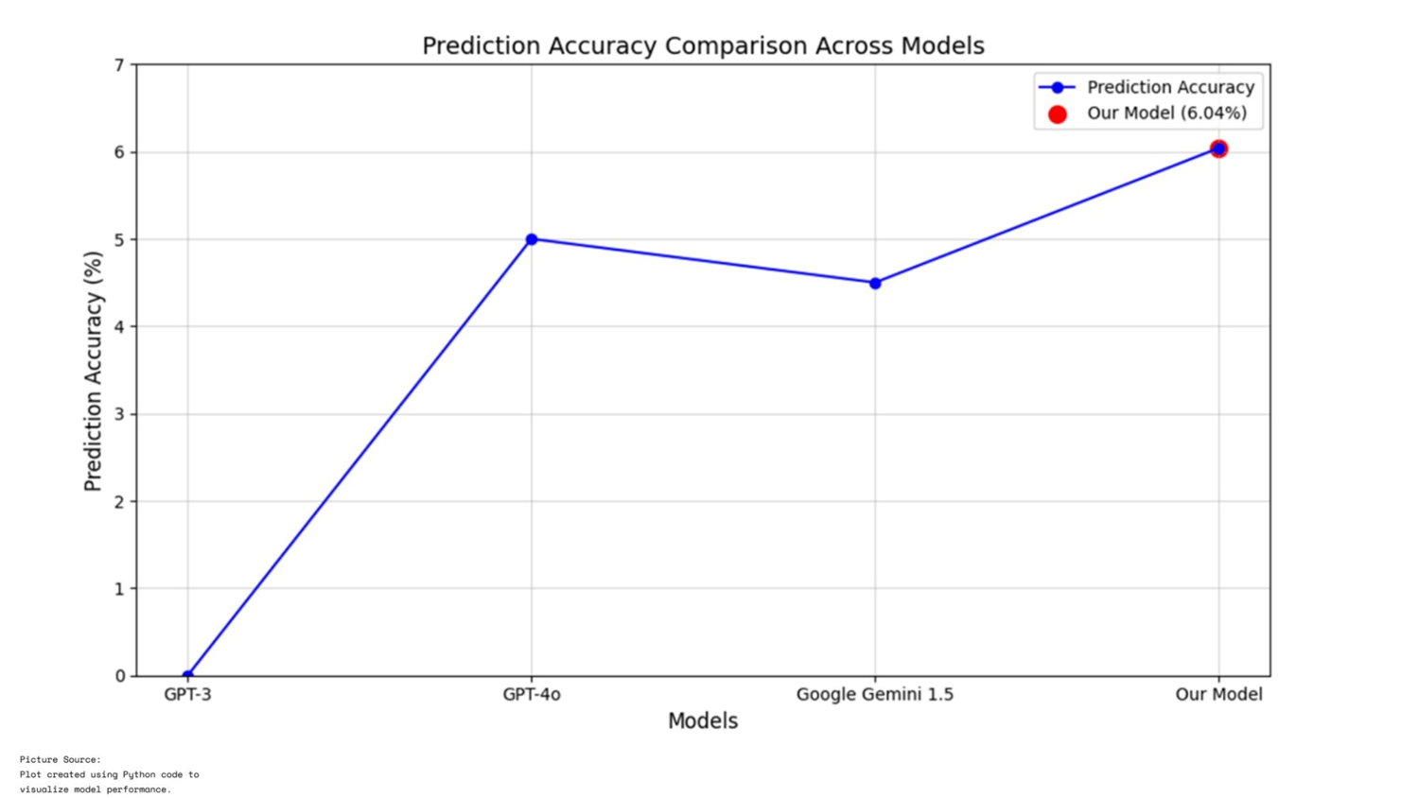

Slide 29
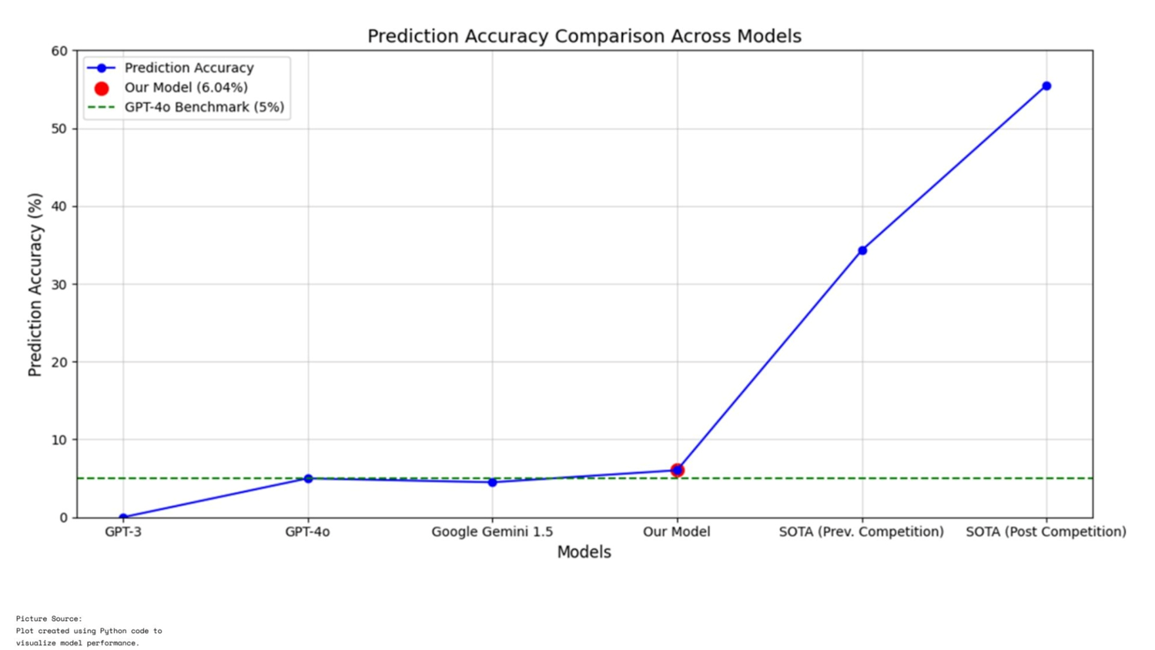

Slide 30
Pixel Accuracy

Slide 31
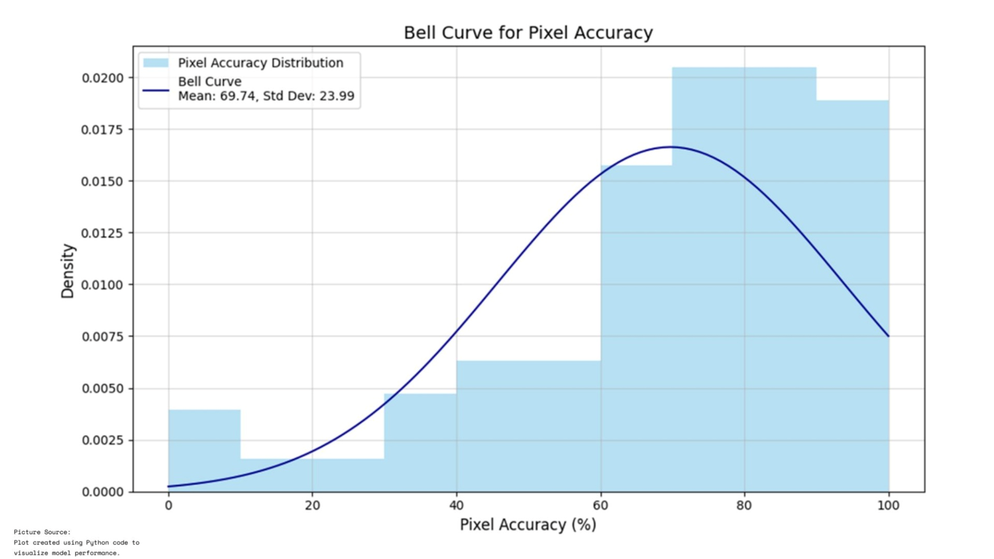

Slide 32
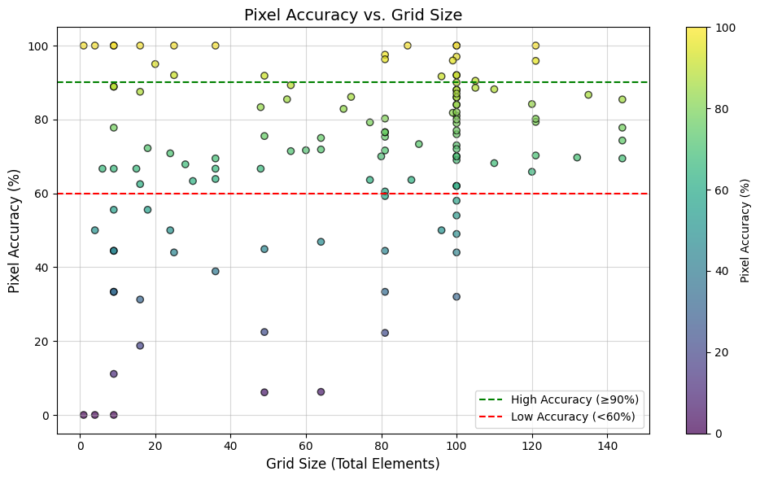

Slide 33
Analysing Model Predictions and Reasonings

Slide 34
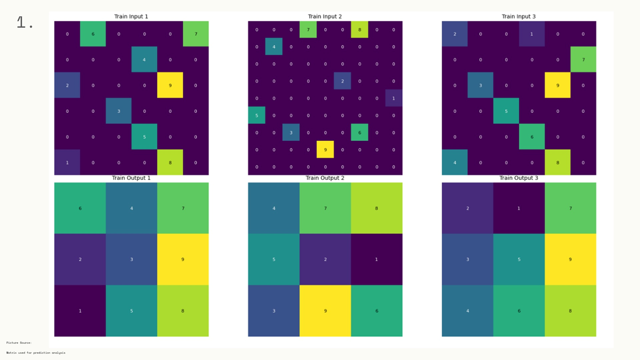

Slide 35
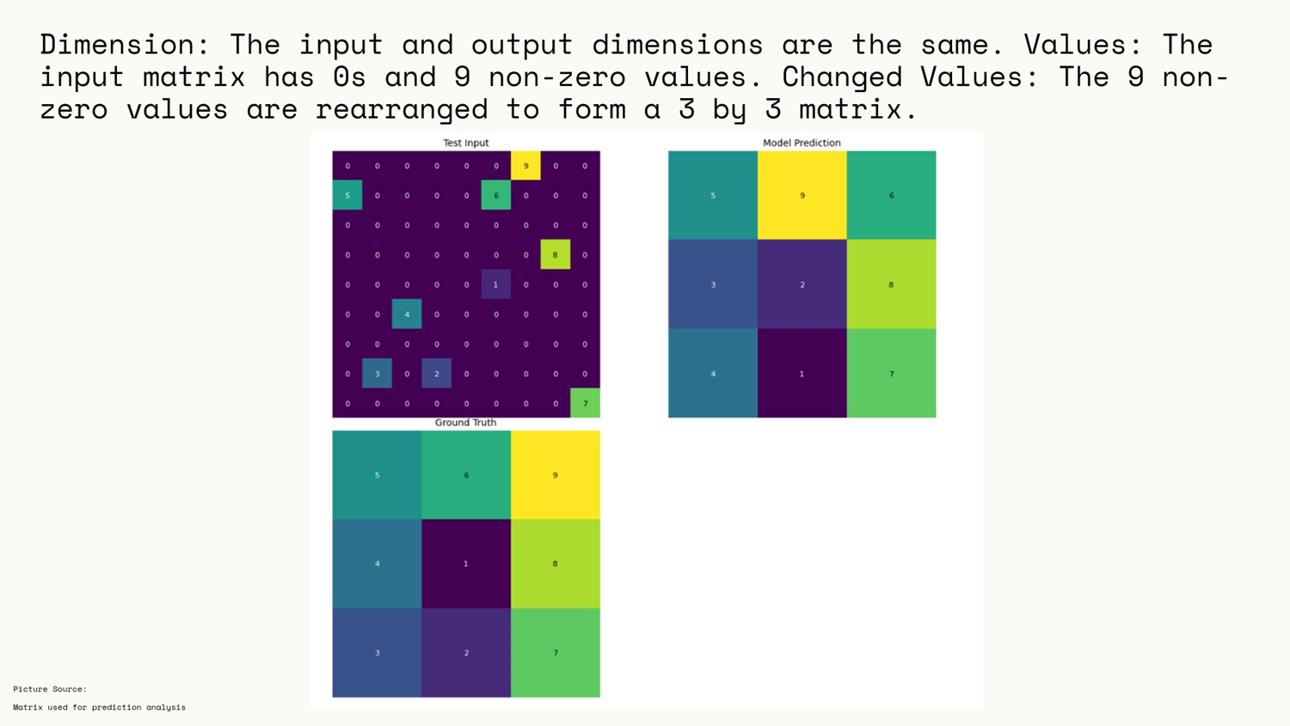

Slide 36
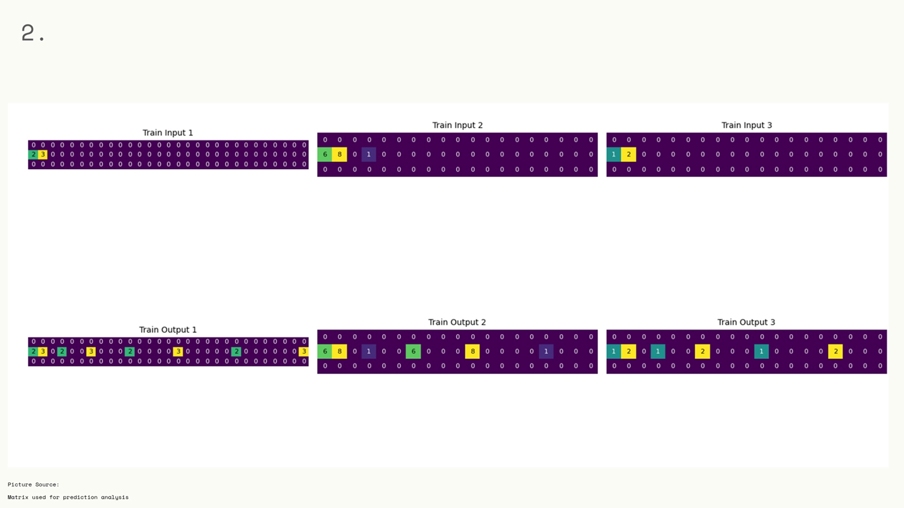

Slide 37
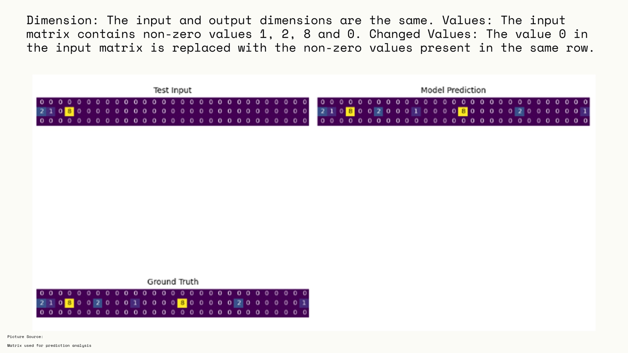

Slide 38
The Model’s Misfire Moments

Slide 39
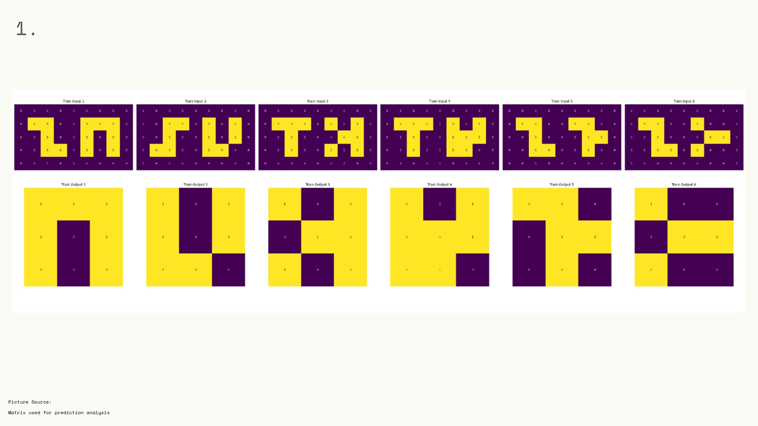

Slide 40
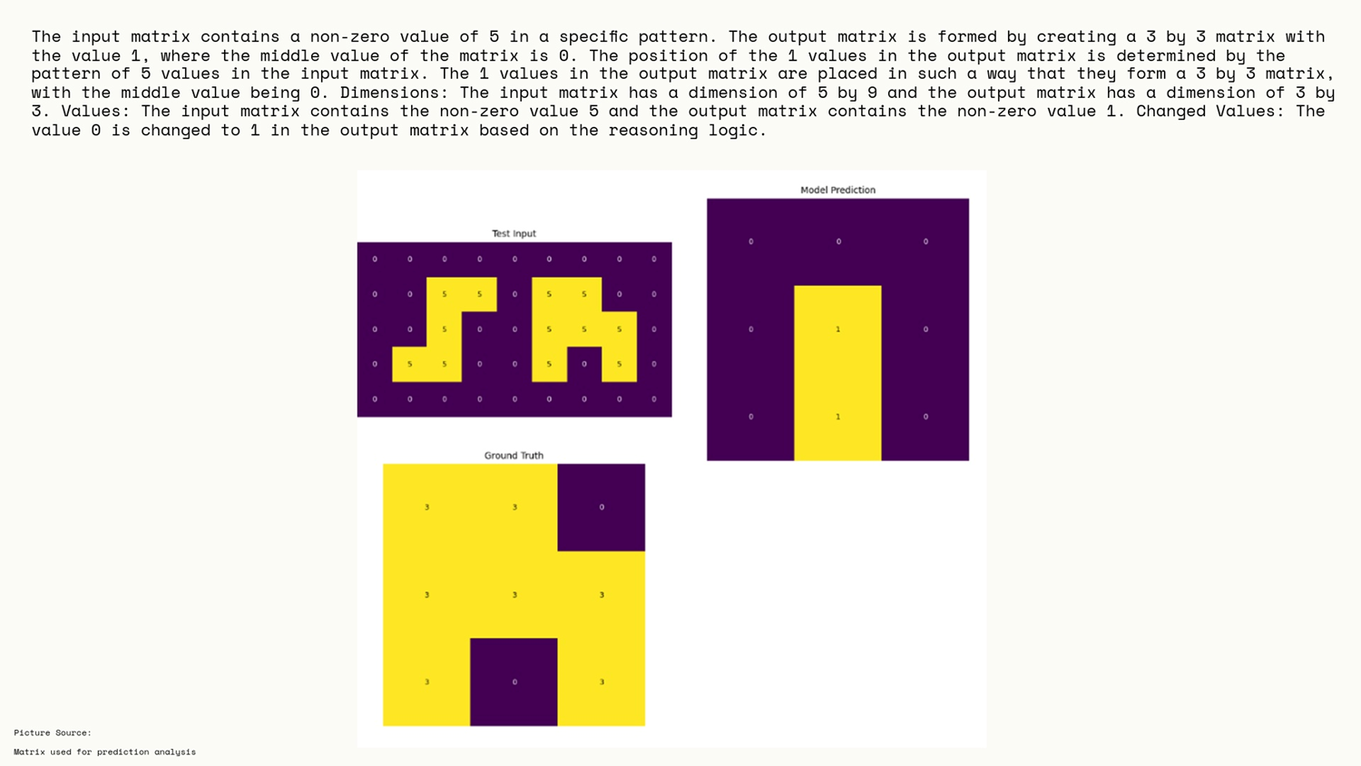

Slide 41
HP-Tuned and Candidate Sampling Results

Slide 42
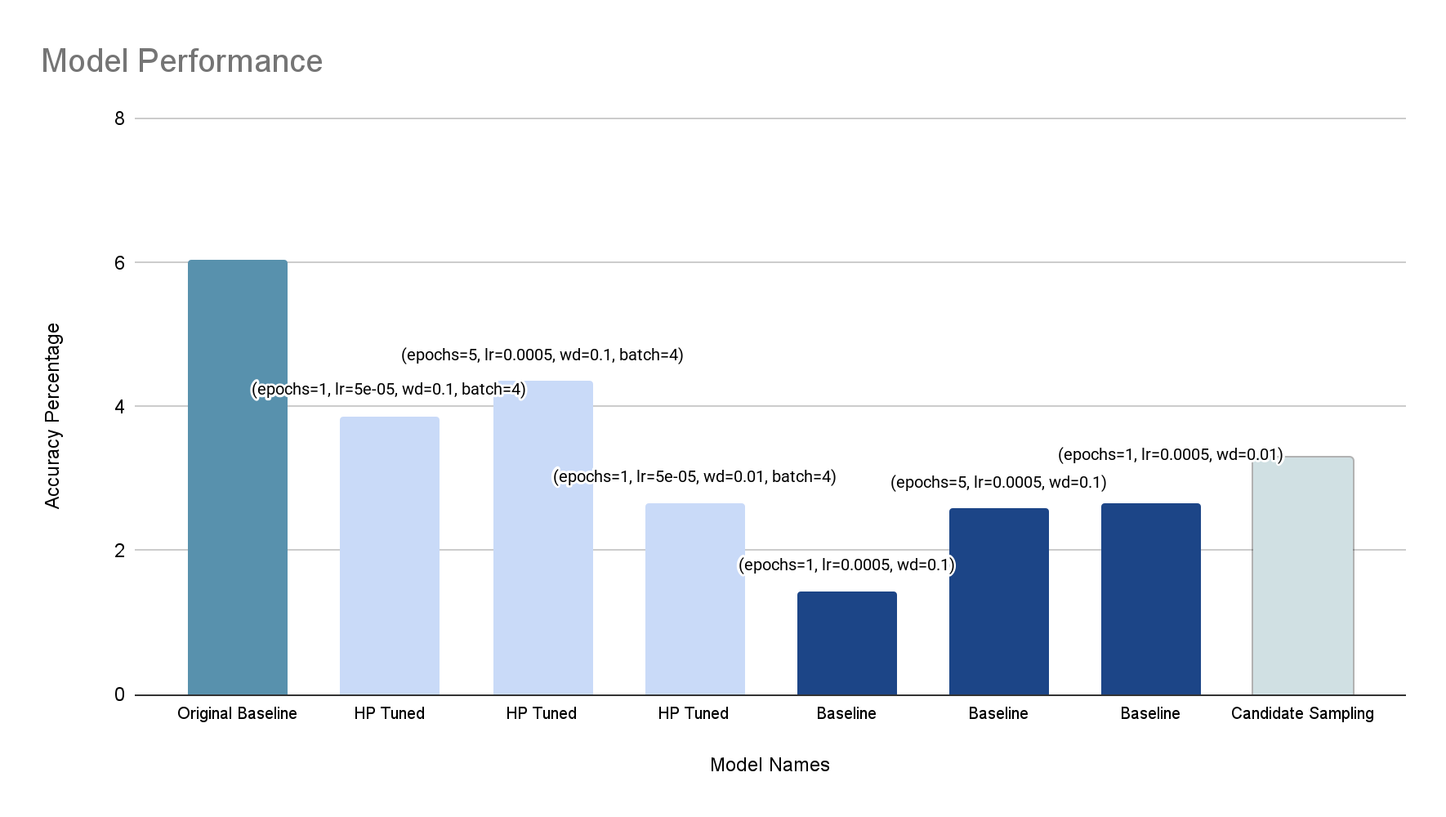

Slide 43
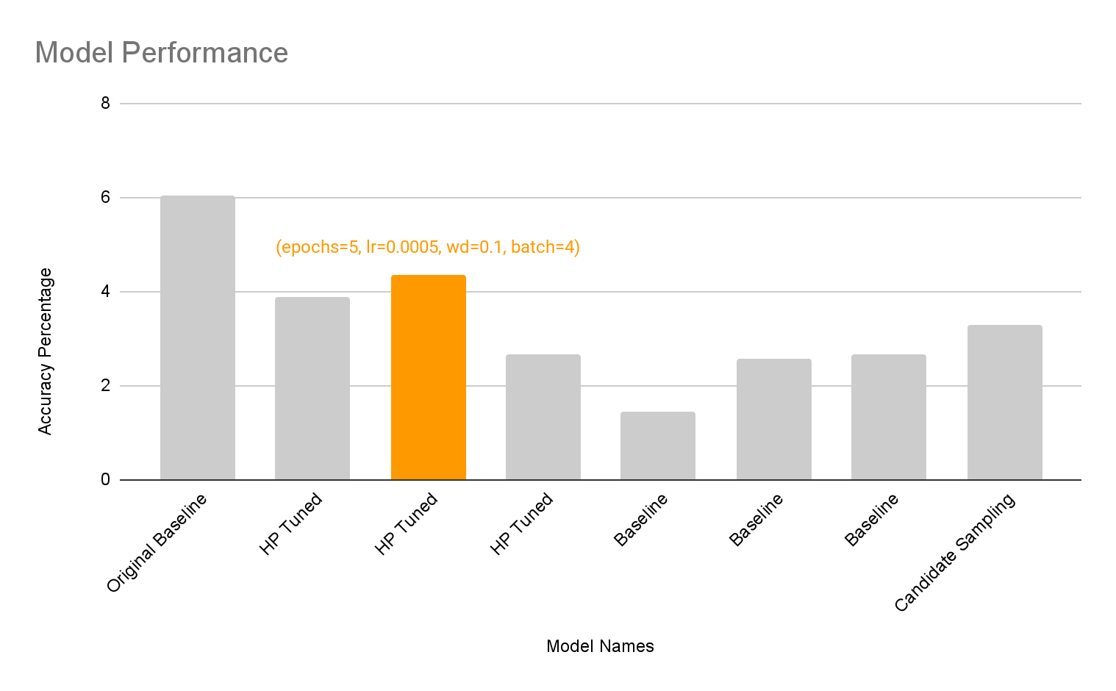
Does HP Tuning Improve ARC Performance?

Slide 44
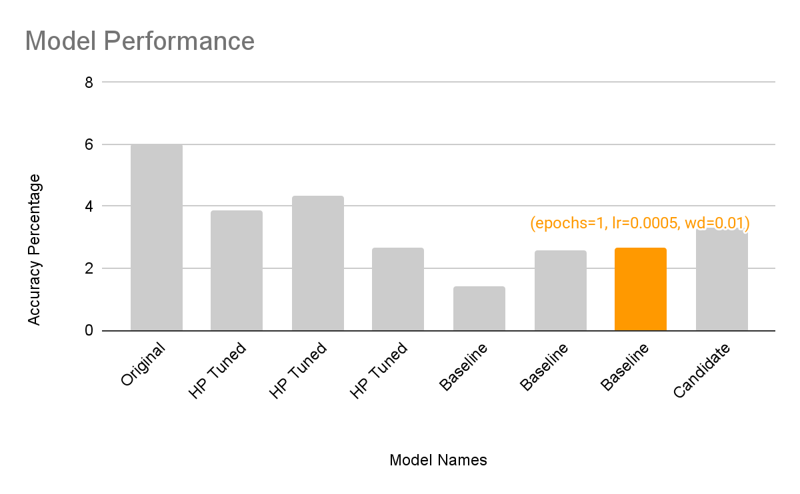
Performance of Baselines Without Reasoning

Slide 45
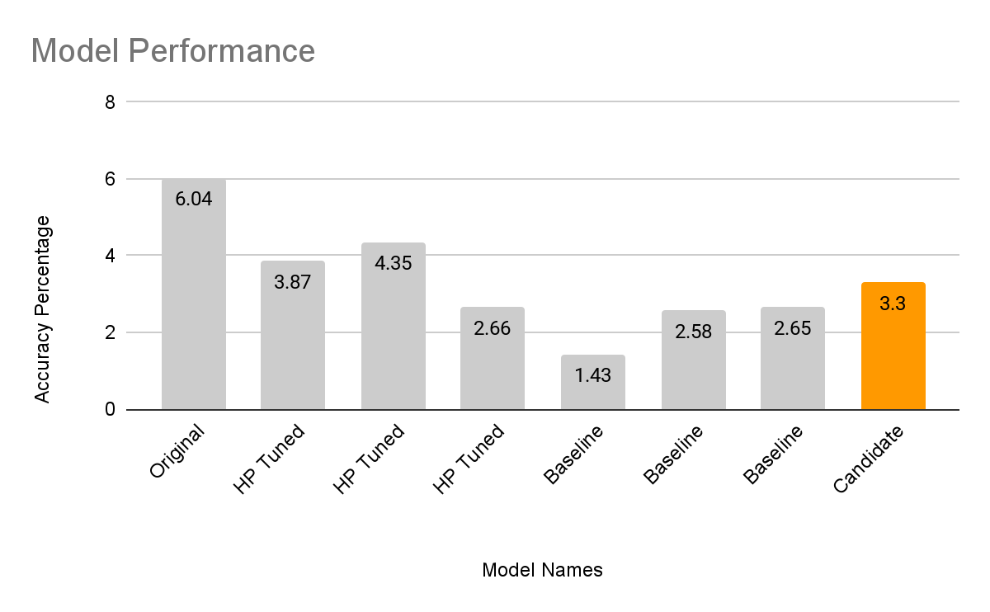
Did Candidate Sampling Help?

Slide 46
Common Errors Across Models

Slide 47
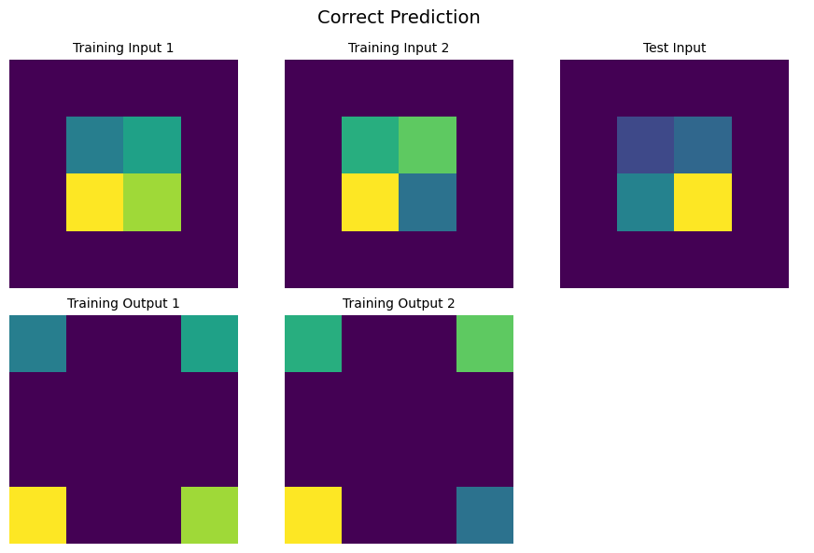

Slide 48
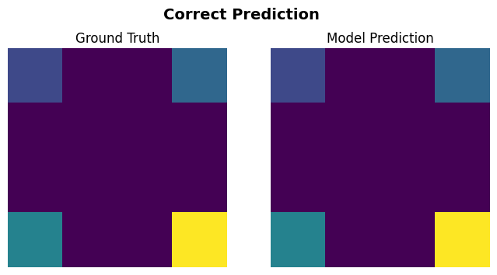

Slide 49
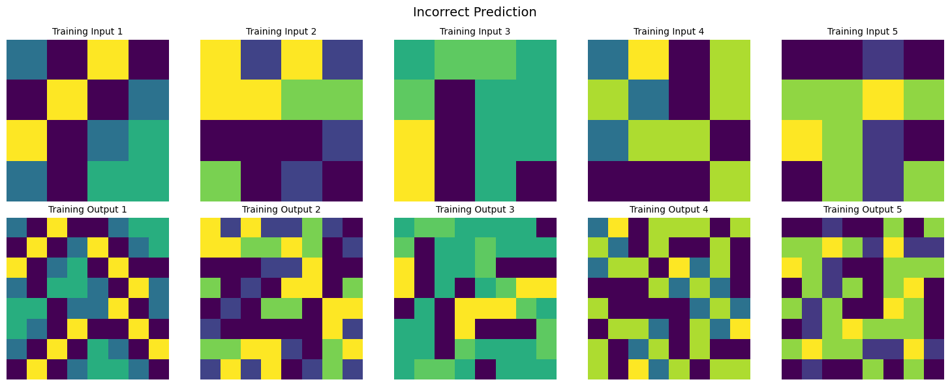

Slide 50
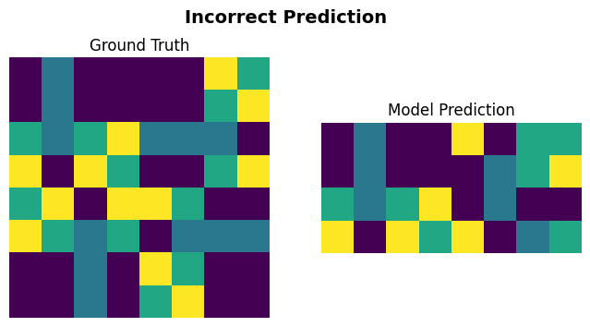

Slide 51
Key Takeaways & Next Steps
Explicit reasoning was crucial, without it, models performed significantly worse!
Candidate Sampling showed promise but needs better negative sampling & ranking mechanisms.
Combine reasoning annotations with ranking mechanisms.

Slide 52
OpenAI’s o3 Model
Achieved 87.5% accuracy on ARC, a massive leap from earlier models (GPT-4 <5%).
Designed to think before answering, unlike previous LLMs that relied on pure pattern matching.
Internal Chain-of-Thought (CoT) Search → Unlike previous LLMs, o3 iterates through solutions before selecting one.

Slide 53
What o3 Means for AGI?
o3 shows that scaling LLMs alone isn’t enough, structured reasoning bridges the gap toward AGI.
Proves that active reasoning (thinking before answering) is crucial for true intelligence.

Slide 54
Thanks for your attention!

Slide 55
Appendix

Slide 56
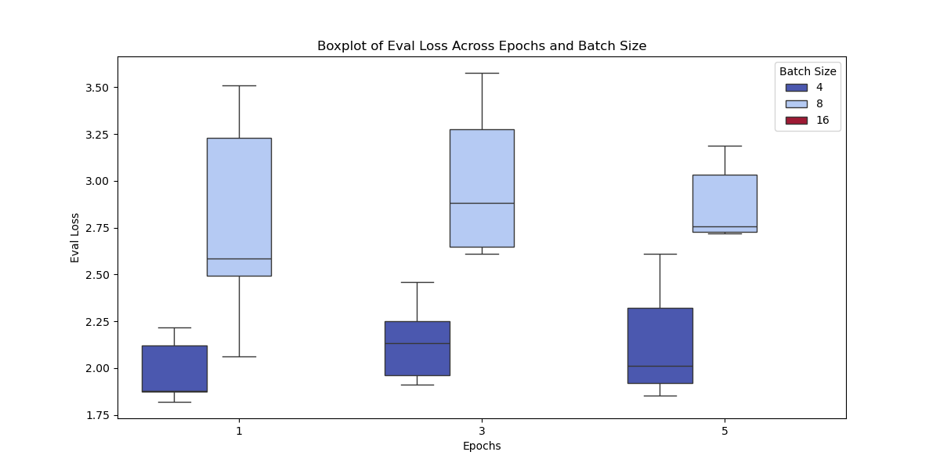
Plots of HP-Tuning without reasonings

Slide 57
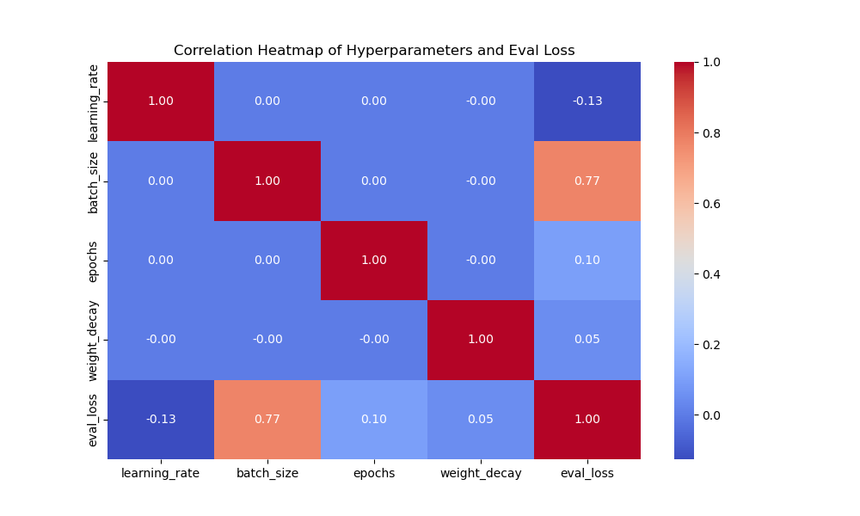
Plots of HP-Tuning without reasonings

